Slide 1
Poker Coach
Alexander Treacy – S15106436

Slide 2
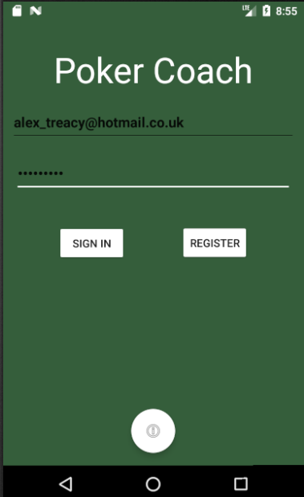
Logging In and registering
Google Firebase has been utilised for user authentication for Poker Coach.
Users can sign in and register using Google Firebase, the user will be able to register for, or sign in to an account using a username and password.

Slide 3
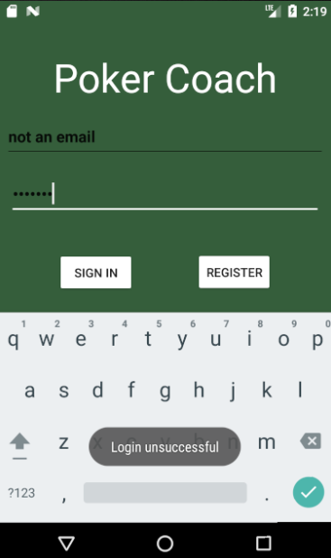
Failed registration/login
When the user has inputted incorrect credentials they will be informed of the error. A toast will be used to display this error message and will not let the user login. Similarly if the user has not inputted a valid username or password then another error will show.

Slide 4
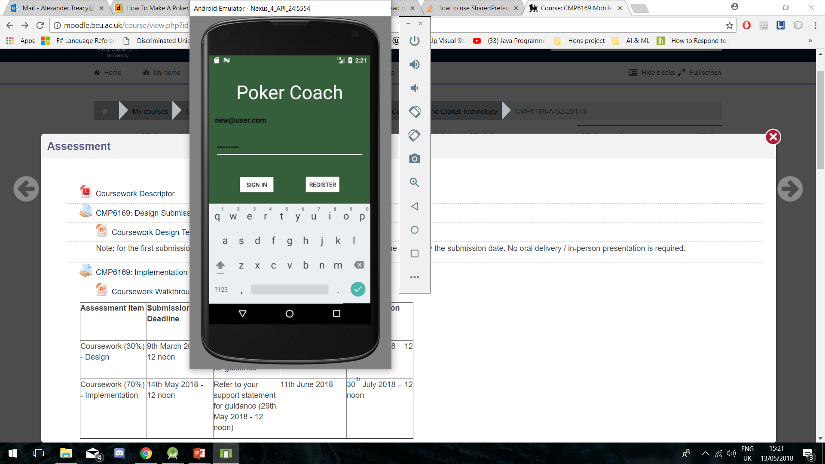
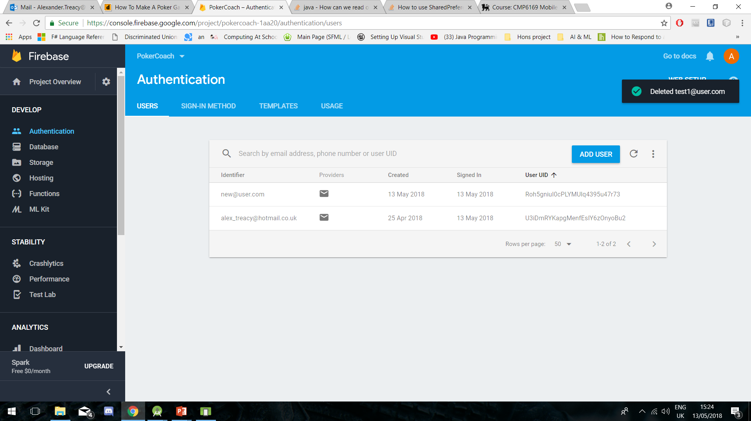
Adding account to Firebase
Once the user has registered then Google Firebase will add this user to the database.

Slide 5
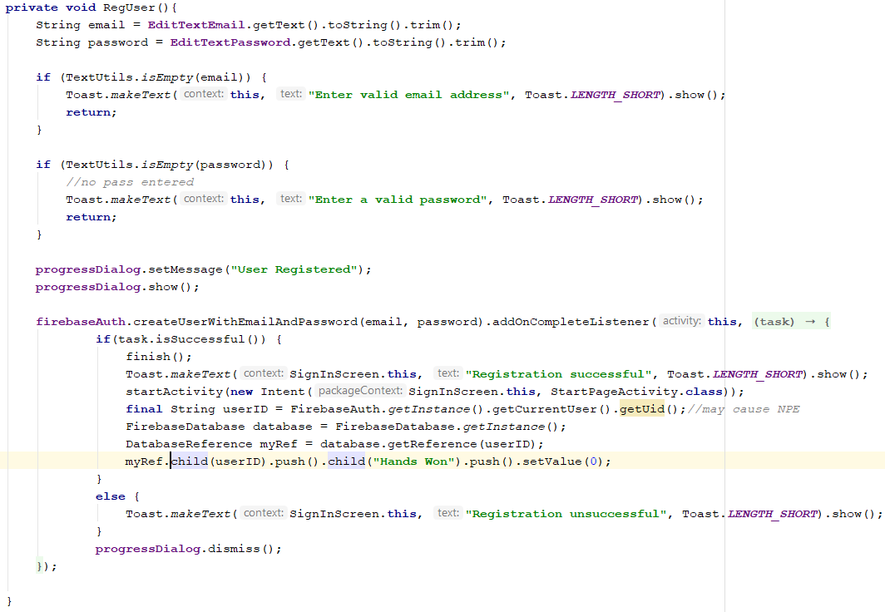
Account registration
For a user to register for an account, they will simply have to click the register button and the information will be updated in Google Firebase authentication. The user can then log in with this information.

Slide 6
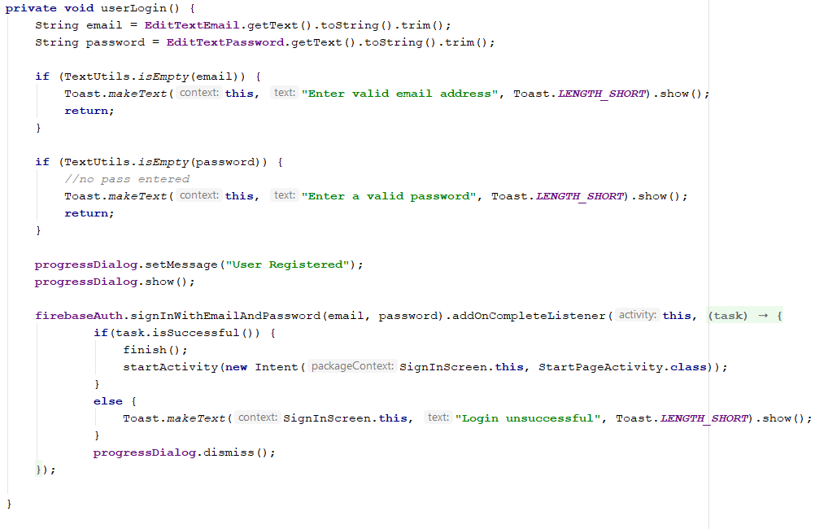
User login
When logging in, the user will input their email and password and Google Firebase will check to see if the account information is correct. Once completed the next screen will be displayed. An onClickListener will be used to get the button which is clicked.

Slide 7
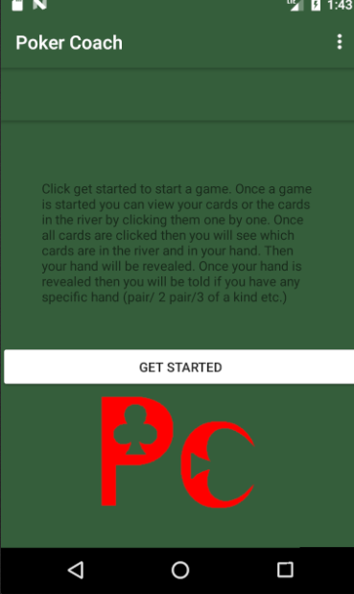
TextView and Setup
The user will be able to select the next screen which will crate the play screen for the user
Setting up the game is the simple means of the touch of a button but this will prompt the class of creating the deck of cards and setting up the user and opponents hand.

Slide 8
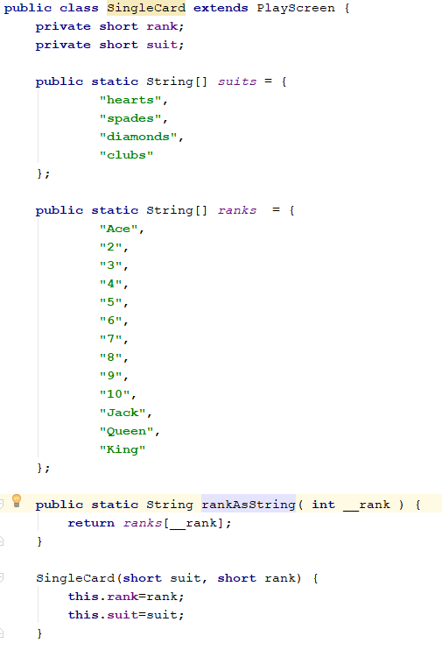
Naming the cards
All of the cards will have a name which will be created from the arrays naming the rank and suit of the card. These are not used within the application, however, were to be used for both testing purposes and future development.
This class can be called at any time to get the name of the card(s) which is drawn.

Slide 9
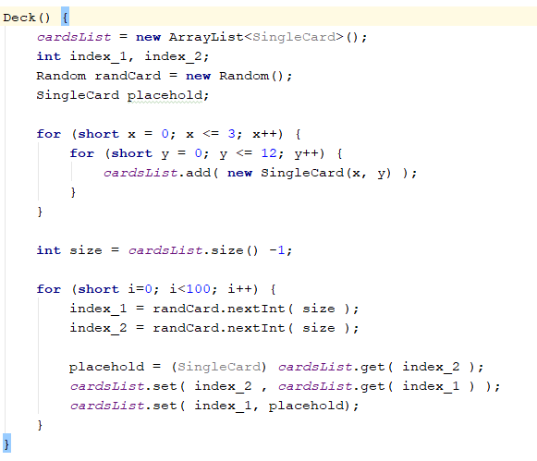
Spawning deck
Creating the deck was the means of creating an array of all cards within the deck. This is done within the same class and can be called whenever a new deck is needed.
This could be created when the ranks, and suits were created for the deck and associations were created for each. The nested for loops will handle the amount of cards to be created.

Slide 10
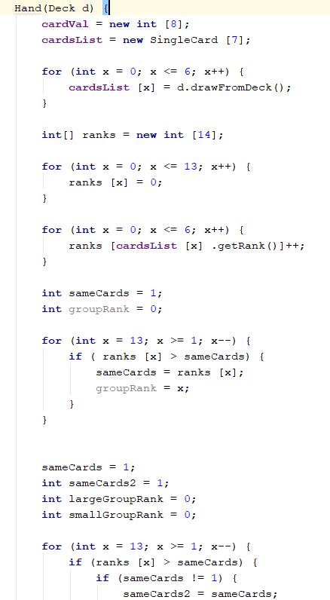
Creating the hand
An array of cards is created for the 5 cards in the river and the 2 in the hand (7).
1-6 represent all of the possible hands from high card (lowest value hand) to royal flush (highest value hand).
This includes the value for a 2 pair and a 3 of a kind as they all include the same rank of card with different suits (see code).
For the tie scenario the user will win in the case of a pair. To even this out the 2 pair will be won by the opponent.

Slide 11
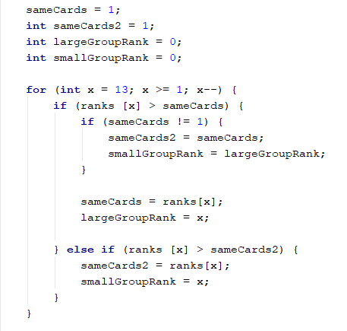
Check for pairs
Check for card pairs and check for any cards which have the same rank.
If any cards have the same rank then check for how many do and put these in the order of ranks from 0-3 (4 values).

Slide 12
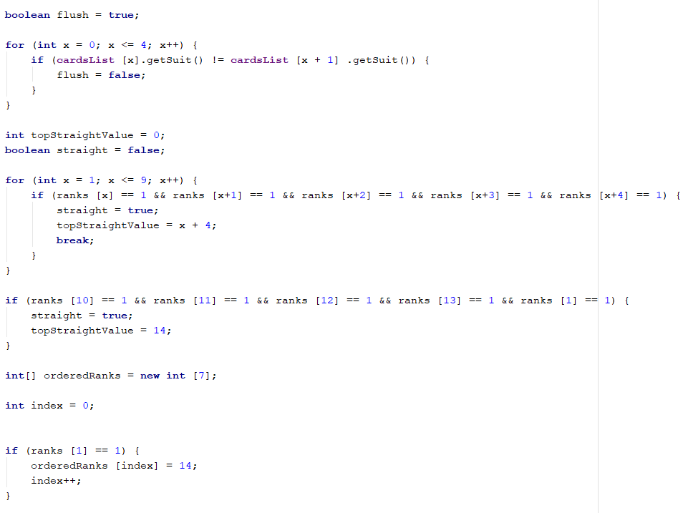
Flush and straight
Checking for a flush is simply making the flush variable true until the for loop checks through to see if the cards are the same rank.
As 9 possible cards exist for a straight to start at, the for loop will check if the straight starts at any of those cards and will check if the straight has an ace as the high card.

Slide 13
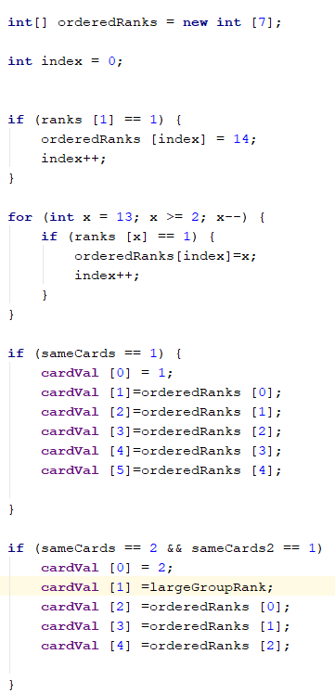
Checking hand rank
To check the hand rank, firstly the rank needs to be stored in an array as the rank will vary between a high card (1) and a straight flush (7).
The variable “sameCards” is used to chec whether cards are a match. This will be used throughout eh application to check for specific hands.
Firstly, the hand will be evaluated and then if statements will be performed to check if the matches on of the card ranks.

Slide 14
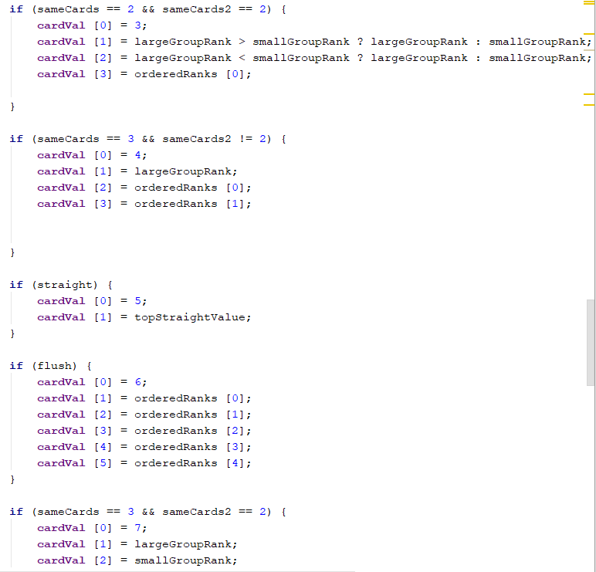
Hands and rankings
When cardVal is equal to 1 then check the card value against the large/smallGroupRank to check for the higher ranking card.

Slide 15
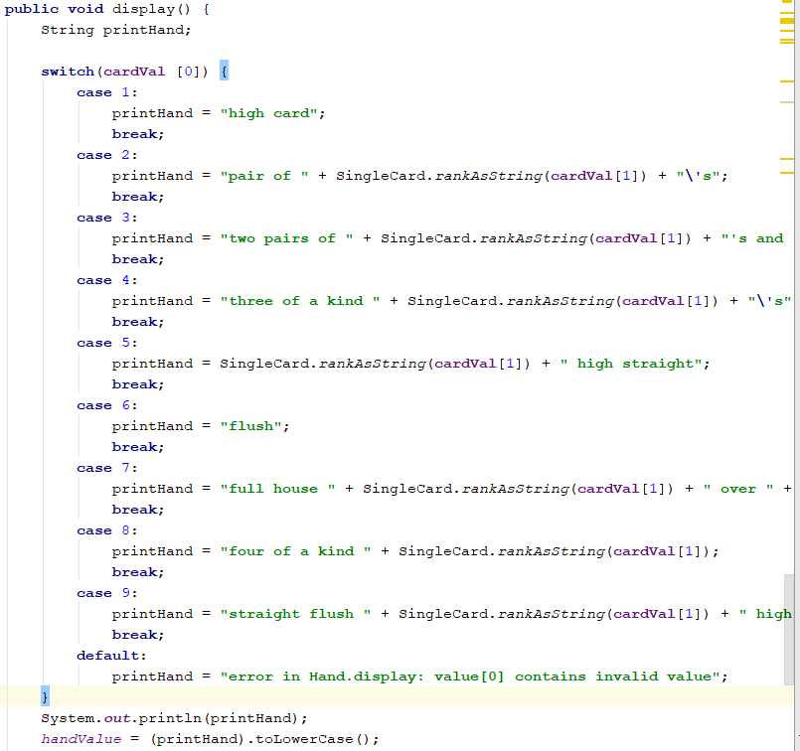
Displaying card
Displaying each card was used for both error checking and for showing the user the value of their current hand.
Creating the handValue variable allows for calling the method and using this variable in the play screen to display the usesrs hand.

Slide 16
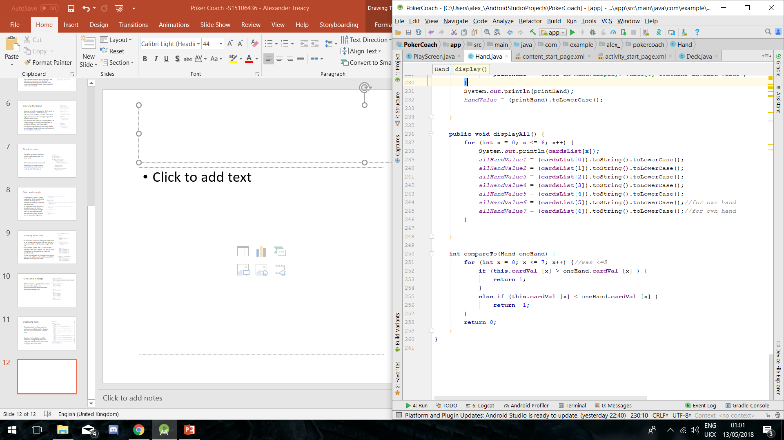
Fetching each card and storing variable
Once all cards are created, a variable will be created to show each of these cards to be referenced to the correct bitmap image later to be used in the application.
As these variables can be called later, the comparing hand method can be created to compare the user and opponents hand and set the oneHand value to a decision based on the winner.

Slide 17
displayAll method
The displayAll method can now be called for testing purposes and will also contain all of the single cards. These cards will be used to be displayed on the play screen when associating the card with an image.

Slide 18
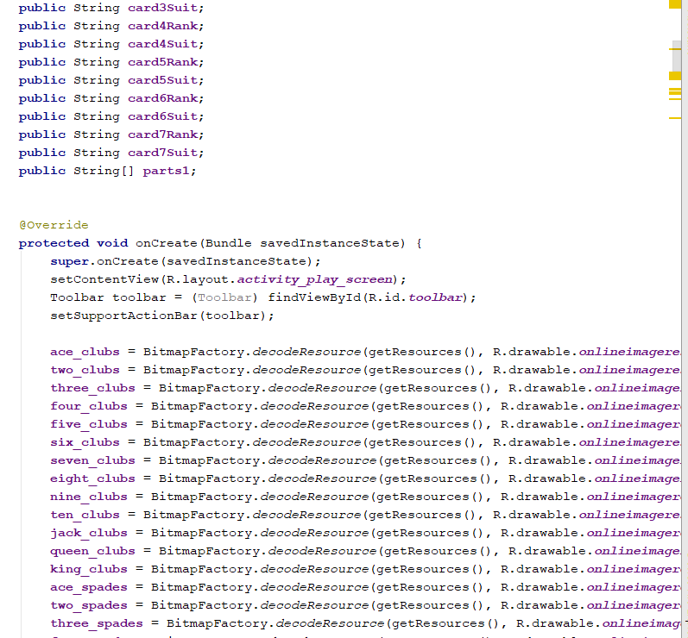
Associations
Creating each card and each association for each of the imageButtons means that the image can be changed based on the name of the card.

Slide 19
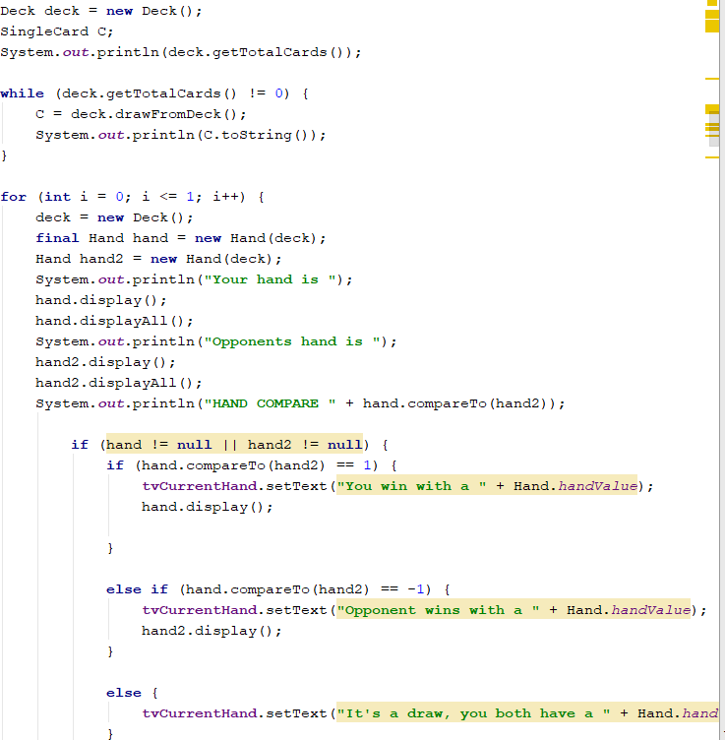
Testing and displaying
Testing and displaying the deck was the means of calling the class and displaying whether the user or the opponent is the winner.
One future development option is the variable(s) created for adding one point to the winner for the amount of wins and losses.

Slide 20
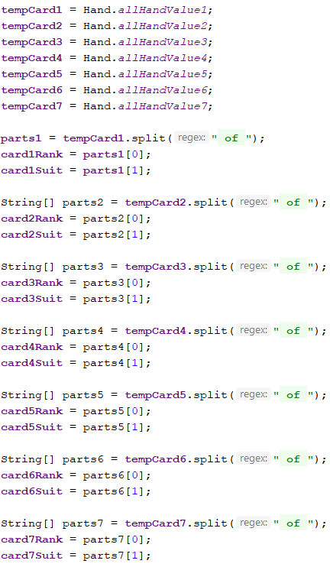
Splitting the cards
Each card will be now split into a suit and a rank, they can now be checked against one another and if/switch statements can be used to display an image based on the card matching the suit and the rank.

Slide 21
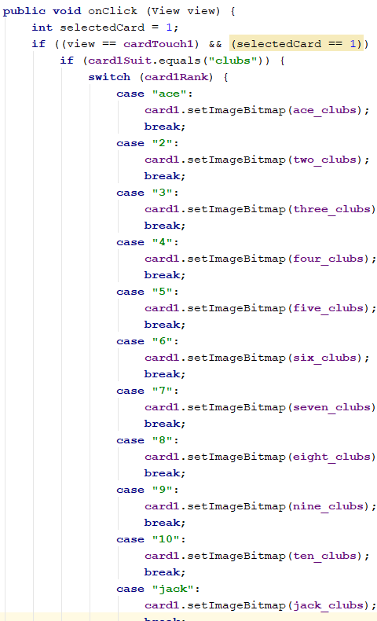
Card matching and displaying
When each of the cards are touched it will reveal the image of the card representing the value and suit of the card. This is done using switch cases for each individual card. This could have been done using a method however, each of the names are unique and would use up the same resources.

Slide 22
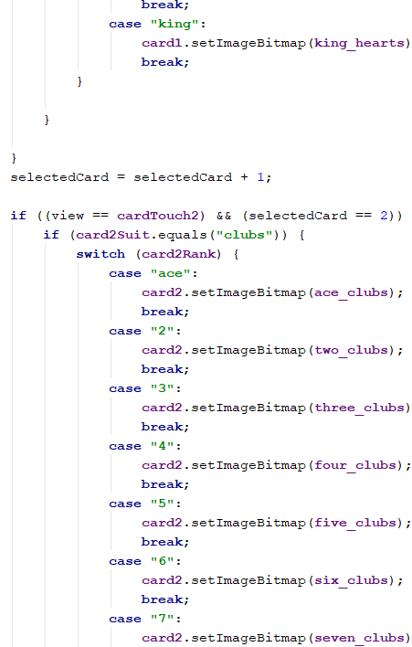
Incrementing selected card
To ensure that the correct card was displayed, the selectedCard value is incremented after each card is clicked. This can now be a condition of whether the next card can be displayed and the user can now choose which card to view next.

Slide 23
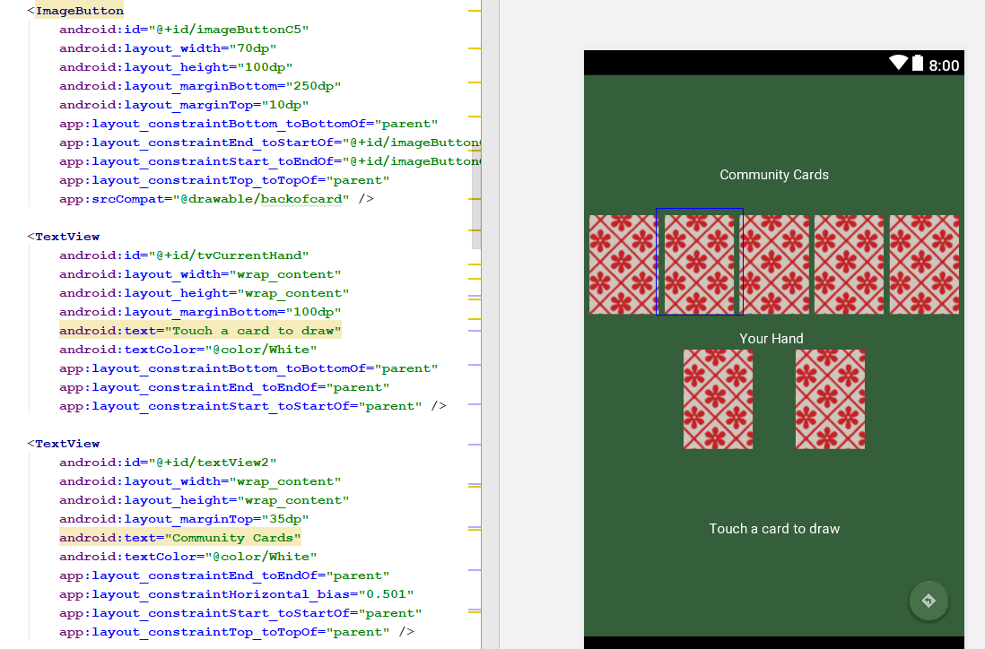
XML play screen
The play screen is a series of imageButtons which will change on click. The textView at the bottom will change depending on the winner of each game and what the winning hand is. (Also to be used as error displaying). A constraint layout was used for the entire application.

Slide 24
Time constraints
Sadly due to time constraints, some aspects of the application are not yet implemented but in future development a betting aspect will be added into Poker Coach. One issue was the hand value and winner being displayed before all cards were drawn but as this is an app for learning poker hands, this is not a major issue. Other future developments include allowing users to select an amount of players and decks.

